Slide 1



NAME :JEENESH E
NMID :3EC7561845574FD82634DA2A1B145C59
REGISTER NO :31024U18020
DEPARTMENT :BSC(COMPUTER SCIENCE)
COLLEGE :THIRUMAGAL MILL'S COLLEGE
UNIVERSITY : THIRUVALLUVAR UNIVERSITY

Slide 2

PROJECT TITLE :
INTERNET AND
WEB

Slide 3

AGENDA :
1.Problem statement
2.Project overview
3.End user
4.Tools and technology
5.Portfolio design and layout
6.Features and functionality
7.Results and screenshots
8.Conclusion

Slide 4

1.PROBLEM STATEMENT :
The project aims to create an informative web page about the internet and web, highlighting their importance, functionality, and impact on modern society. The goal is to educate users about the basics of the internet and web, their differences, and their role in shaping the digital world.

Slide 5

2.PROJECT OVERVIEW :
The "Internet and Web" project is a web-based application designed to provide users with a comprehensive understanding of the internet and web. The project will include interactive features, informative content, and a user-friendly interface to engage users and facilitate learning.

Slide 6

3.END USER:
The end users of this project are:
- Students: seeking to learn about the basics of the internet and web
- Educators: looking for resources to teach students about the internet and web
- General users: interested in understanding the fundamentals of the digital world

Slide 7
The project will utilize the following tools and technologies:
- HTML (Hypertext Markup Language): for structuring and organizing content
- CSS (Cascading Style Sheets): for styling and layout
- JavaScript: for adding interactivity and dynamic effects
- GitHub: for version control and collaboration
4.TOOLS AND TECHNOLOGY :

Slide 8

The portfolio design will feature a clean and modern layout, with the following sections:
- Header: featuring the project title, author name, and contact information
- Main Content: divided into sections about the internet and web
- Footer: including links to GitHub and other relevant reso
urces
5.PORTFOLIO DESIGN AND LAYOUT :

Slide 9

The project will include the following features and functionality:
- Informative content: about the internet and web
- Interactive elements: such as hover effects and animations
- Responsive design: ensuring a smooth user experience across devices
- Easy navigation: allowing users to quickly access different sections of the website
6.FEATURES AND FUNCTIONALITY :

Slide 10
The project will yield the following results:
- A fully functional web page with informative content about the internet and web
- A visually appealing design that engages users and facilitates learning
- Interactive features that enhance the user experience
Screenshots of the project will showcase the design, layout, and features of the web page.
7.RESULT :

Slide 11
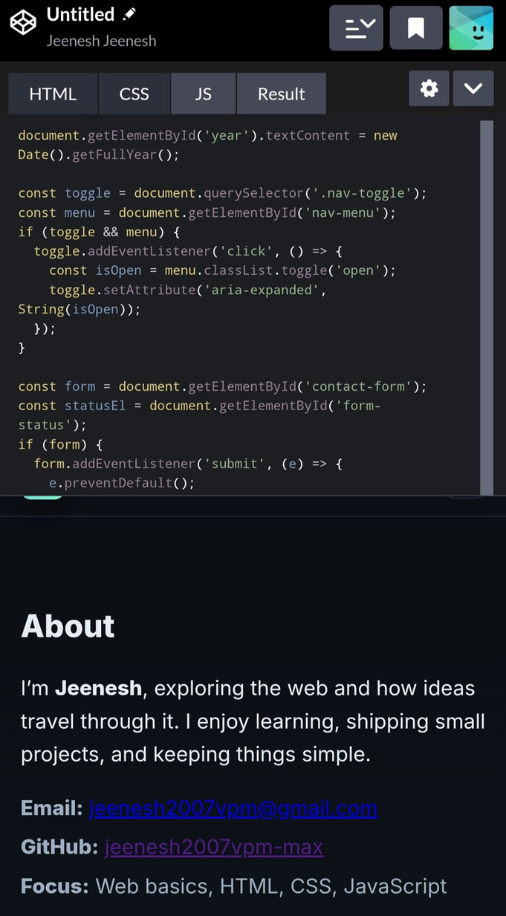
SCREENSHOT :

Slide 12
8.CONCLUSION :
The "Internet and Web" project aims to educate users about the fundamentals of the digital world. By utilizing HTML, CSS, and JavaScript, the project will create an engaging and informative web page that provides users with a comprehensive understanding of the internet and web. The project's interactive features and responsive design will ensure a smooth user experience, making it an effective tool for learning and education

Slide 13

Cyber Security
THANK YOU
-

